Slide 1
Movie Recommendation System
Tharun Gopi

Slide 2

Purpose
Movie Recommendation system
The purpose of this project is to give recommendations for users based on the viewing history and ratings given on movies.
We have used the MovieLense data from Kaggle which was updated 3 months back to the Kaggle site.
We have used the same dataset for building the recommendation system using Databricks and Scala.

Slide 3
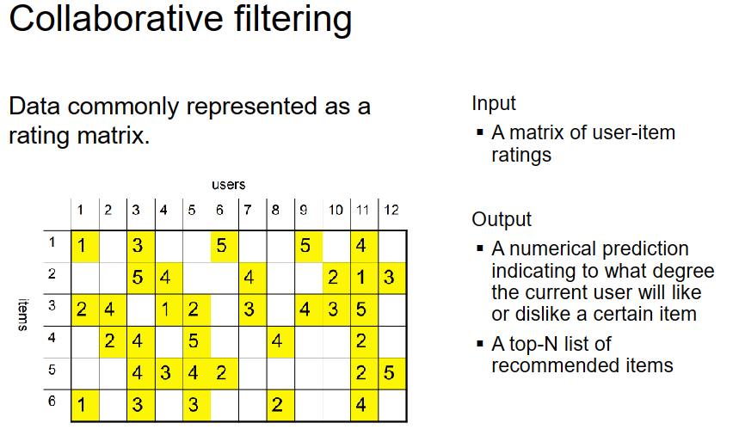
Movie Recommendation system
We have used the Machine learning approach to make the prediction for users depending on his past choices and ratings of the movies.
Here we have used Collaborative filtering and Spark ALS to build the recommendation system.
We have used Advanced filtering mechanism to predict possible recommendations for concerned users depending upon their preference.
The project has been developed using Databricks and Scala.
Spark MLLIB – ALS Model is the Collaborative Filtering Model. It provides Matrix Factorization to build missing Ratings on the user/item matrix.
The recommendation System is built based on the predictive model MatrixFactorizationModel of MLlib ALS, which is now extended as ALS
Slide reference from ML-812 course

Slide 4
Movie Recommendation system
Collaborative filtering
Collaborative filtering works on building a matrix.
Step 1: Read ratings of all users on Item (Movie ID) to build the rating matrix.
Step 2: Factorize the Rating matrix into two user matrix and item matrix. User matrix where rows represent users and columns are latent factors; the other being item matrix where rows are latent factors and columns represent items.
User Interaction Matrix = User Matrix X Movie Matrix(Item Matrix)
Step3: While doing the factorization process. The missing rating values can be filled. Once all the missing ratings value are filled, it can be used for making the recommendation.
Collaborative filtering – thru Advanced filtering mechanism ALS Model
MatrixFactorization is done thru MLlib ALSModel,
ALSModel offers a method called
recommendProducts.
recommendProducts takes two parameters: user id and the number of items to be returned.
The model predicts the top number of items a user will like. Here the items are the Movie ID

Slide 5
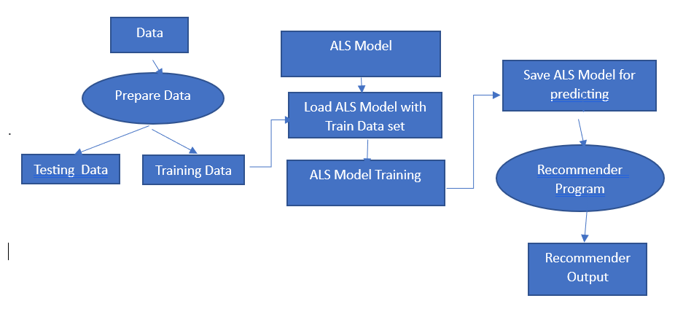
Movie Recommendation system
Approach
Import Data into Databricks
Use Ratings data to build the Movie Recommendation system
Split the data into Training and Test
For Collaborative filtering, Create ALS Model and train the model
This ALS Model automatically builds the movie rating matrix, predicting user ratings to movies they haven’t seen yet
Use this model to make recommendation for a user

Slide 6
Steps continued…
Movie Recommendation system
Pre-processing:
%scala
//Import Movielense data for Ratings and Movies datasets into Databricks
val ratings_DF = spark.read.format("csv").option("header", "true").load("/FileStore/tables/ratings.csv")
val movies_DF = spark.read.format("csv").option("header", "true").load("/FileStore/tables/movies.csv")
ratings_DF.createOrReplaceTempView("ratings")
movies_DF.createOrReplaceTempView("movies")
Splitting data for training and testing
// Randomly split ratings RDD into training data RDD (70%) and test data RDD (30%)
val splits = ratings_DF.randomSplit(Array(0.70, 0.30), seed = 12345L)
val (trainingData, testData) = (splits(0), splits(1))
val ratingsRDD = trainingData.rdd.map(row => {
val userId = row.getString(0)
val movieId = row.getString(1)
val ratings = row.getString(2)
val title = row.getString(3)
Rating(userId.toInt, movieId.toInt, ratings.toDouble) })
Map Training set
Map Testing Data Set
val testRDD = testData.rdd.map(row => {
val userId = row.getString(0)
val movieId = row.getString(1)
val ratings = row.getString(2)
val title = row.getString(3)
Rating(userId.toInt, movieId.toInt, ratings.toDouble)
})

Slide 7
Steps continued…
Movie Recommendation system
Build Model and Train
val model = new ALS()
.setIterations(10) .setBlocks(-1) .setAlpha(1.0) .setLambda(0.10)
.setRank(10) .setSeed(22L) .setImplicitPrefs(false) .run(ratingsRDD)
def computeRMSE(model: MatrixFactorizationModel, data: RDD[Rating],
implicitPrefs: Boolean): Double = {
val predictions: RDD[Rating] = model.predict(data.map(x => (x.user, x.product)))
val predictionsAndRatings = predictions.map(x => ((x.user, x.product), x.rating))
.join(data.map(x => ((x.user, x.product), x.rating))).values
if (implicitPrefs) {
println("(Prediction, Rating)")
println(predictionsAndRatings.take(5).mkString("\n"))
}
math.sqrt(predictionsAndRatings.map(x => (x._1 - x._2) * (x._1 - x._2)).mean())
}
Evaluation of the model
RMSE = computeRMSE(model, testRDD, true)
val ratingsRDD = trainingData.rdd.map(row => {
val topRecsForUser = model.recommendProducts(232, 5)
for (rating <- topRecsForUser) {
println(rating.toString())
}
Predict and Recommend movie to a user (232)
println("Recommendations: (MovieId => Rating)")
println("----------------------------------")
val recommendationsUser = model.recommendProducts(232, 5)
recommendationsUser.map(rating => (rating.product, rating.ratings )).foreach(println)
println("----------------------------------")

Slide 8
Code Execution results…
Movie Recommendation system
Pre-processing:
ratings_DF: org.apache.spark.sql.DataFrame = [userId: string, movieId: string ... 2 more fields] movies_DF: org.apache.spark.sql.DataFrame = [movieId: string, title: string ... 1 more field]
Training: 73552 Test: 31787 splits: Array[org.apache.spark.sql.Dataset[org.apache.spark.sql.Row]] = Array([userId: string, movieId: string ... 2 more fields], [userId: string, movieId: string ... 2 more fields
Splitting data for training and testing
trainingData: org.apache.spark.sql.Dataset[org.apache.spark.sql.Row] = [userId: string, movieId: string ... 2 more fields]
Map Training set
Map Testing Data Set
testData: org.apache.spark.sql.Dataset[org.apache.spark.sql.Row] = [userId: string, movieId: string ... 2 more fields]
TrainingCount: Long = 73552
TestCount: Long = 31787

Slide 9
Code Execution results…
Movie Recommendation system
Build Model and Train
model: org.apache.spark.mllib.recommendation.MatrixFactorizationModel = org.apache.spark.mllib.recommendation.MatrixFactorizationModel@51fd4916
(Prediction, Rating) (3.529921280451396,4.0)
(3.09508283655362,2.0)
(4.509512729564007,4.5)
(4.020447079706175,5.0)
(3.0209081019317434,1.0)
Evaluation of the model
RMSE = computeRMSE(model, testRDD, true)
Test RMSE = 0.9137996239271179 model:
Rating:(UserID, MovieID, Rating)
----------------------------------
Rating(232,81191,5.645141834653451) Rating(232,77658,5.093775767173218) Rating(232,104319,5.080627711651974) Rating(232,80969,5.023785247976262) Rating(232,59810,5.02262829802474)
----------------------------------
Predict and Recommend movie to a user (232)
Recommendations: (MovieId => Rating)
----------------------------------
(81191,5.645141834653451)
(77658,5.093775767173218)
(104319,5.080627711651974)
(80969,5.023785247976262)
(59810,5.02262829802474)
----------------------------------
Here the model predicts movie recommendations for user 232

Slide 10
THANK YOU
Tharun Gopi (tgopi@uwm.edu)

